Slide 1
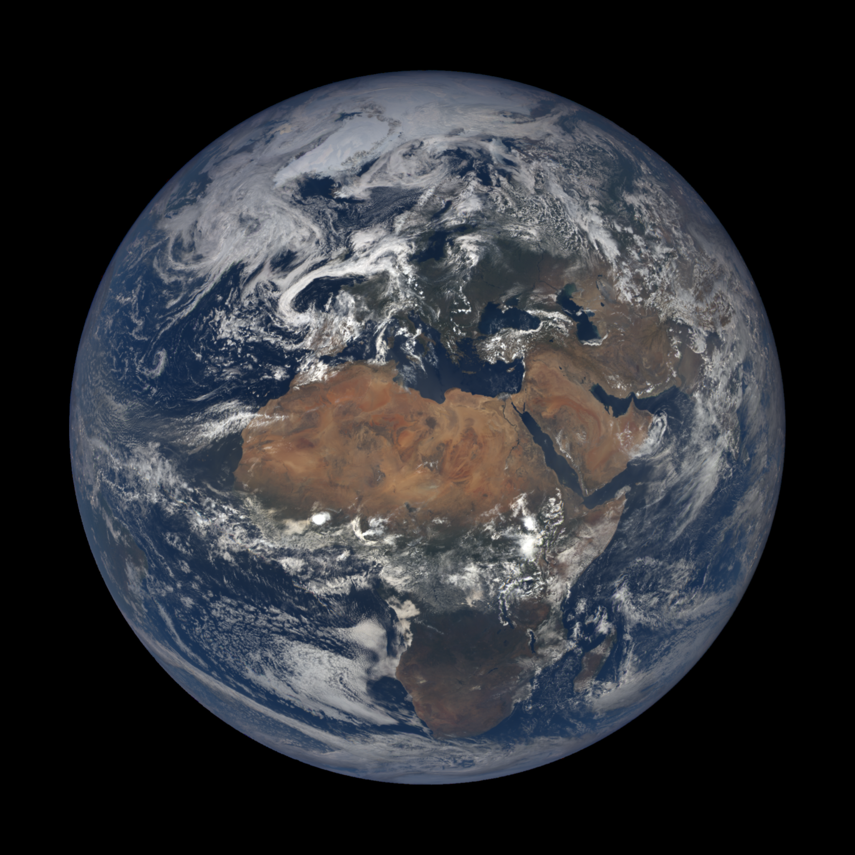
On This Day
On This Day

Slide 2
Team
Zach Selindh
William Gannon
Raymond Fwu
Sunny Liao

Slide 3
On This Day
Description -
Take a user input date, return random event information on Wikipedia and relevant YouTube videos.

Slide 4
APIs
Wikipedia
The most challenge we encountered during this project is the right parameter combination for
the API call to generate the event list when user selects a date.
YouTube
NASA

Slide 5
Result
User can use DayPicker to select a day he/she is interested in to see what has happened before, at the same time YouTube provides a video relevant to the selected date.
NASA API provides user unique experience daily by generating new background image from the unknown outer space.
https://apod.nasa.gov/apod/calendar/allyears.html

Slide 6
Delegation

